Slide 1
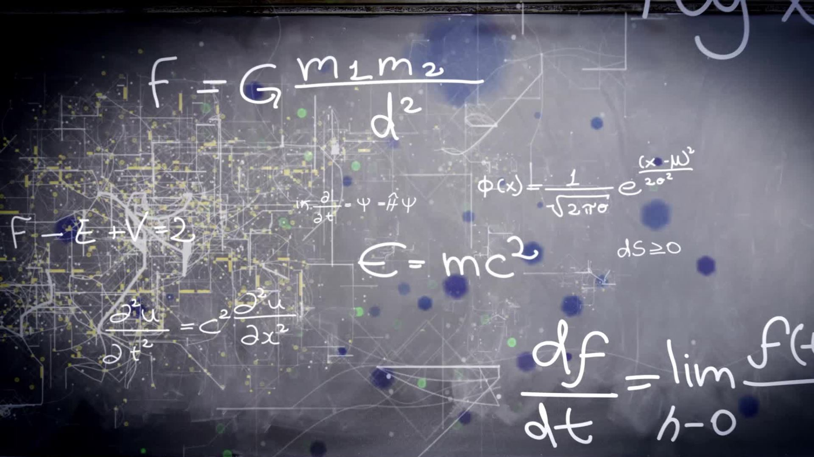
CSCI-4950 Final Project
Ian Roberson

Slide 2
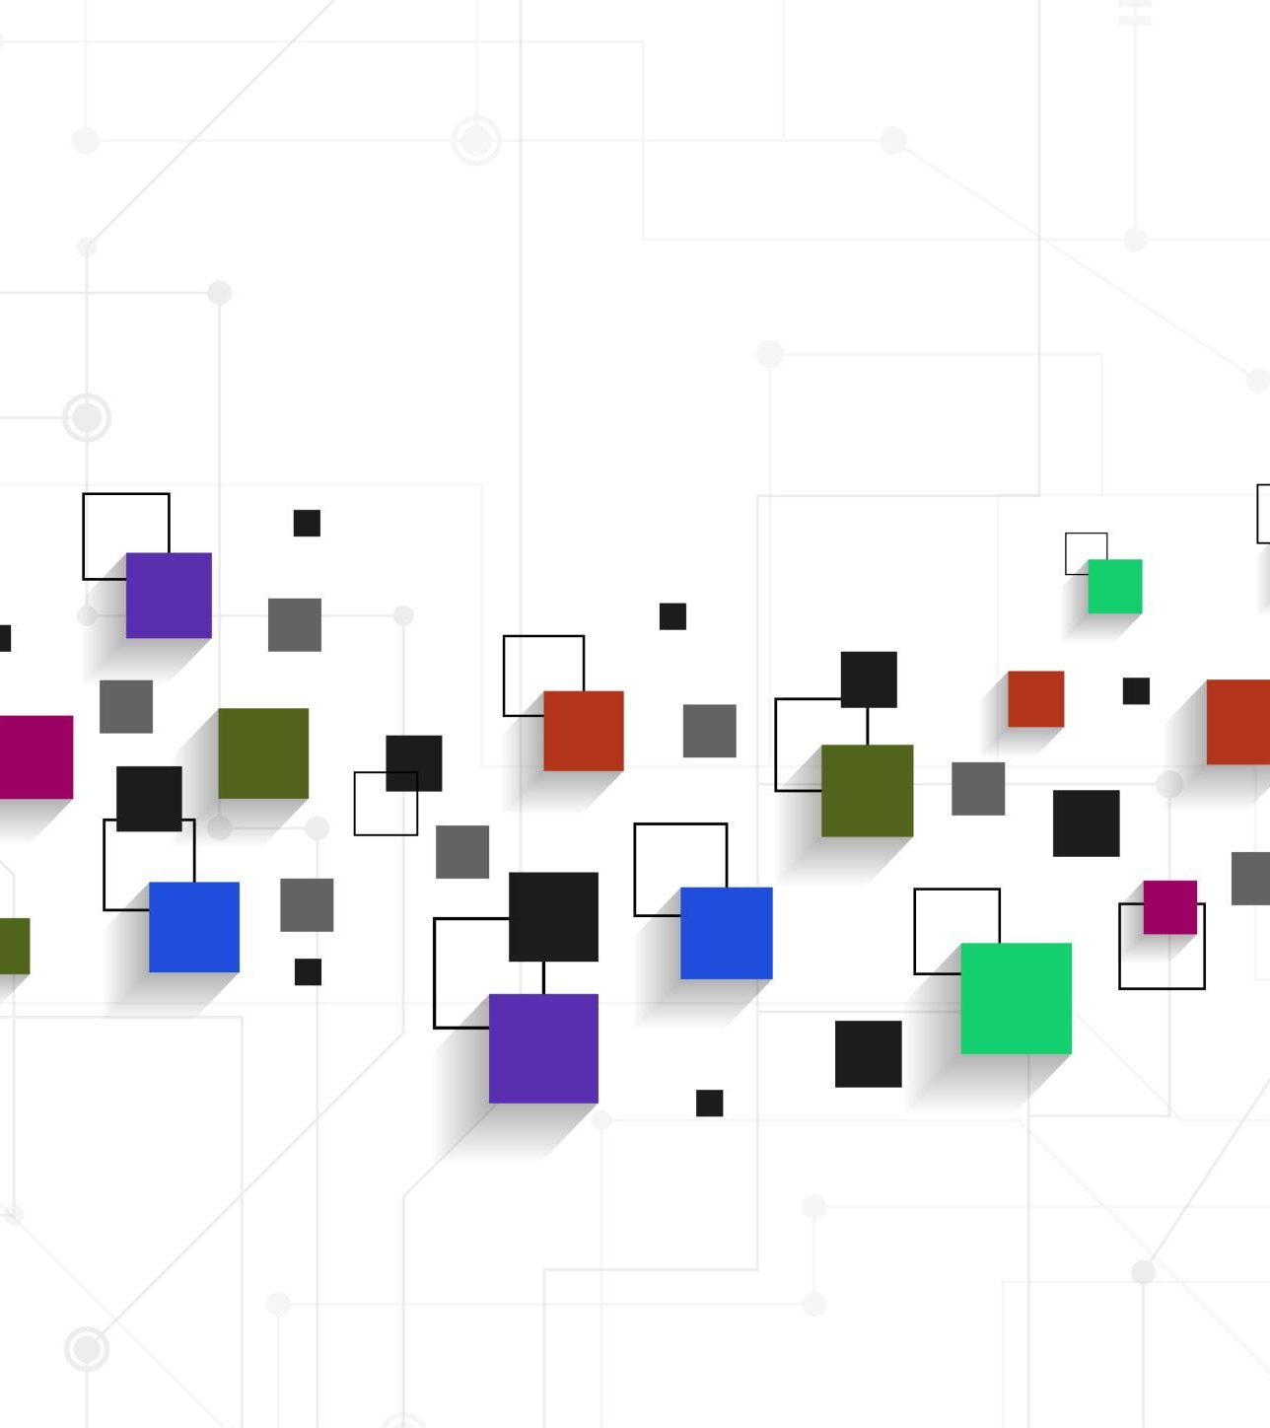
Image Processing
Split dataset into fractured and not fractured
Read each image with Skimage
Converting all images in the dataset to grayscale
Resize all images to 128x128 pixels
Flatten each image to a 1D array
Append 1D array to data list

Slide 3

Fracture Detection Algorithm
Scikit-Learn SVC machine learning approach
Tensorflow Neural Network deep learning approach

Slide 4
Scikit Learn - Support Vector Classifier (SVC)
Shuffle and stratify (ensures proper distribution) data
Split data into train and test sets (20% of data used to test accuracy)
Define set of hyperparameters (gamma, C or smoothness of the decision boundary)
Perform grid search to find best estimator
Dump model using Pickle

Slide 5
SVC Machine Learning Performance
97.2% accuracy in both test and validation
Training periods take a very long time
Overall, fairly simple to use

Slide 6
Tensorflow Deep Learning Neural Network
Shuffle and stratify (ensures proper distribution) data
Split data into train and test sets (20% of data used to test accuracy)
Define model architecture
Implement early stopping (prevents the model from over-training)
Compile model with Adam optimizer for binary classification
Train model for set number of epochs
Save model with Tensorflow's build in save function

Slide 7
Tensorflow Neural Network Performance
Short training times
Provides helpful information during training process (shows the change in accuracy each iteration)
Test Case: 97.2%
During validation, correctly identified 413 out of 600 images (68.8%)
Most likely the current model is overfitting

Slide 8
Loading Model for Validation
Perform same image processing to validation set
SVC:
Load model with Pickle
Tensorflow:
Load model with Tensorflow

Slide 9
Conclusions
SVC simpler to use
SVC machine learning approach was more accurate
Training time was significantly lower for Tensorflow
Tensorflow provided helpful information during the training process making changes easier to visualize
Unable to get to an acceptable accuracy for Tensorflow

Slide 10

Questions?

